Slide 1

Grocery Delivery Management System
Udeshika Dissanayake (s3400652)
Assignment 2 | COSC2640 Cloud Computing| Semester1 2020 RMIT

Slide 2
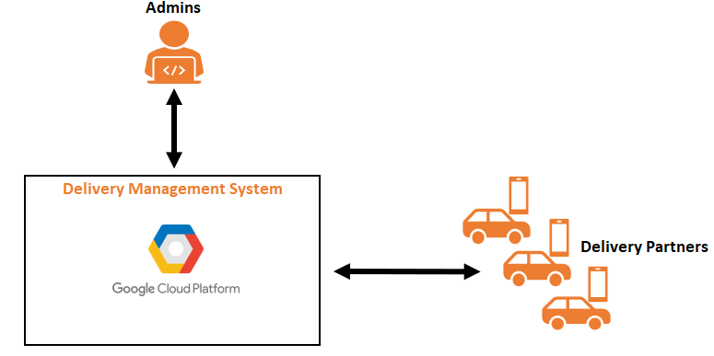
Summary
A Platform developed to manage online Delivery Orders.
Connects System Owner (Admin) to Third-Party Delivery Partners (DPs) in order to efficiently manage Delivery Orders.
Application Features:
Web Application - https://cloud-function-test-274101.ts.r.appspot.com/
Login for multiple Admins
Login for multiple DPs
WhatsApp Messaging for Delivery Notification
Automated Travel Distance
Automated Travel Time
Calculates Delivery Fee based on Travel Distance
Query Passed Delivery Order and Show Details
Admin View
DP View
Interactive Dashboard
Admin
DPs
Show drop-off locations on interactive map
Contact Us form
System Features
Distributed System Architecture
Highly Scalable
Real-Time Operation
Serverless Architecture for most of Event-Driven Computations
Cost Efficient Deployment on GCP – pay as per use
Easily Upgradable (add or modify features) due to Modular Architecture
Minimal Latency

Slide 3
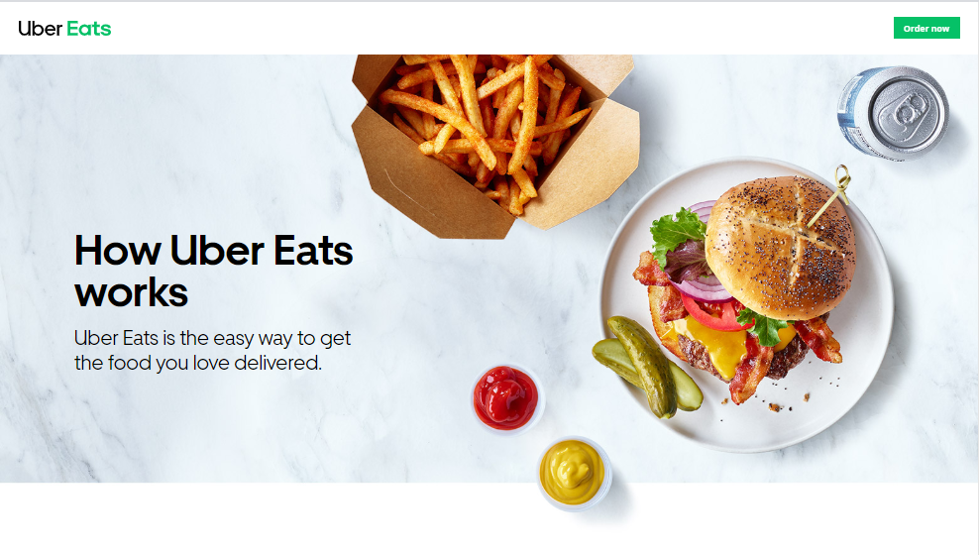
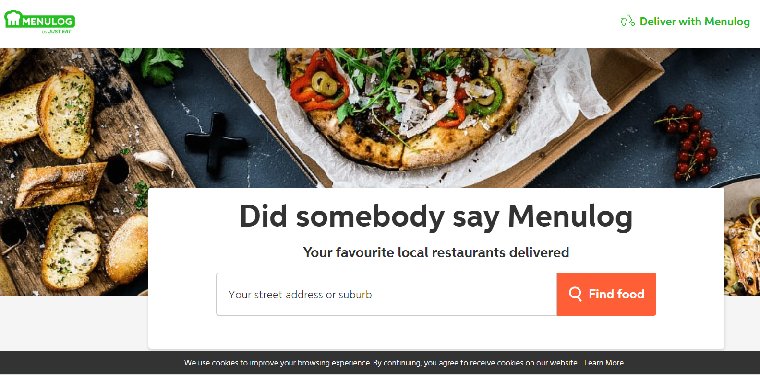
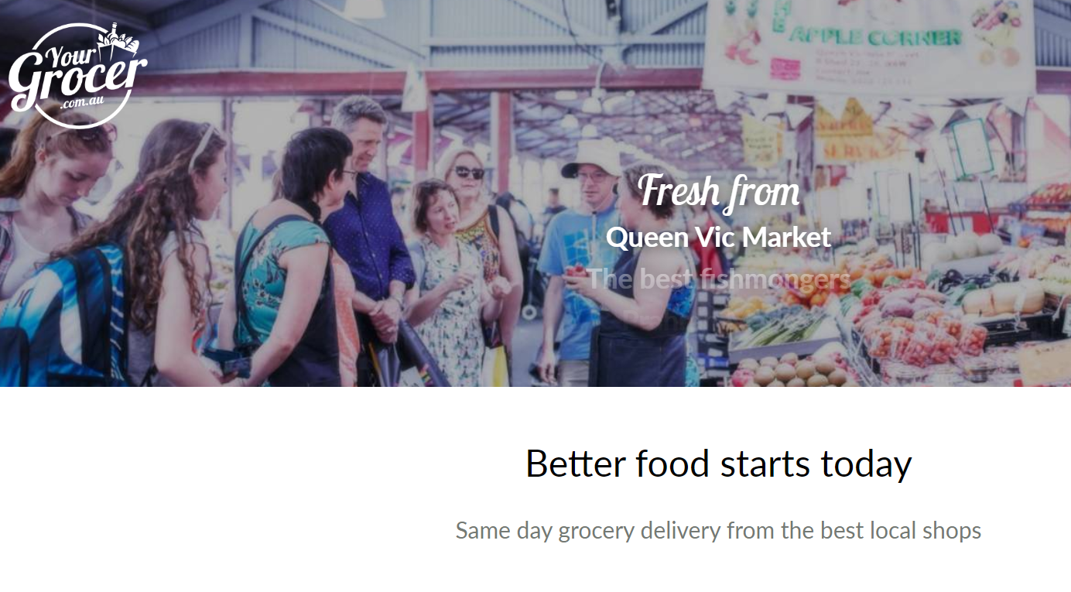
Related Work
Admin and Third-Party Delivery Partner Relationship – UberEats, Menulog, YourGrocer

Slide 4
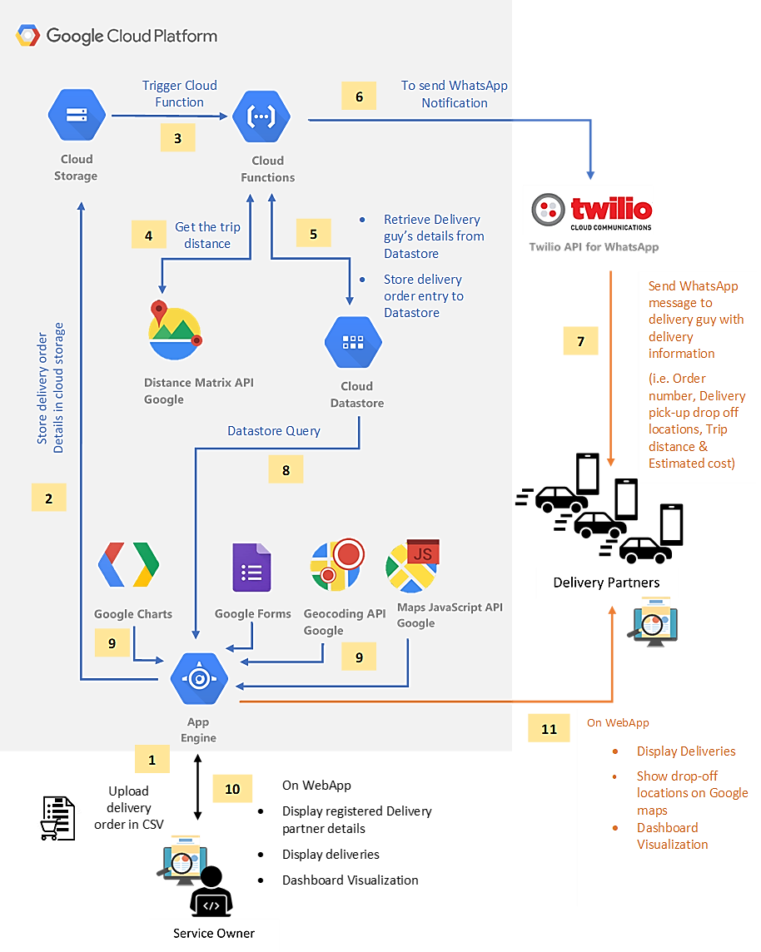
Software Design/Architecture
Services Used
Coding Language – PHP, HTML/CSS, JaveScript, Node.js
Google App Engine
Google Functions – Bucket Trigger and HTTP Trigger
Google Cloud Storage
Google Could Datastore
Google Distance Matrix API
Google Geocoding API
Google Maps JavaScript API
Twilio API for WhatsApp
Google Charts
Google Forms

Slide 5
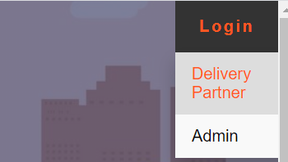
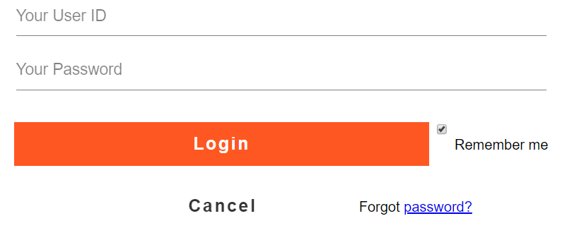
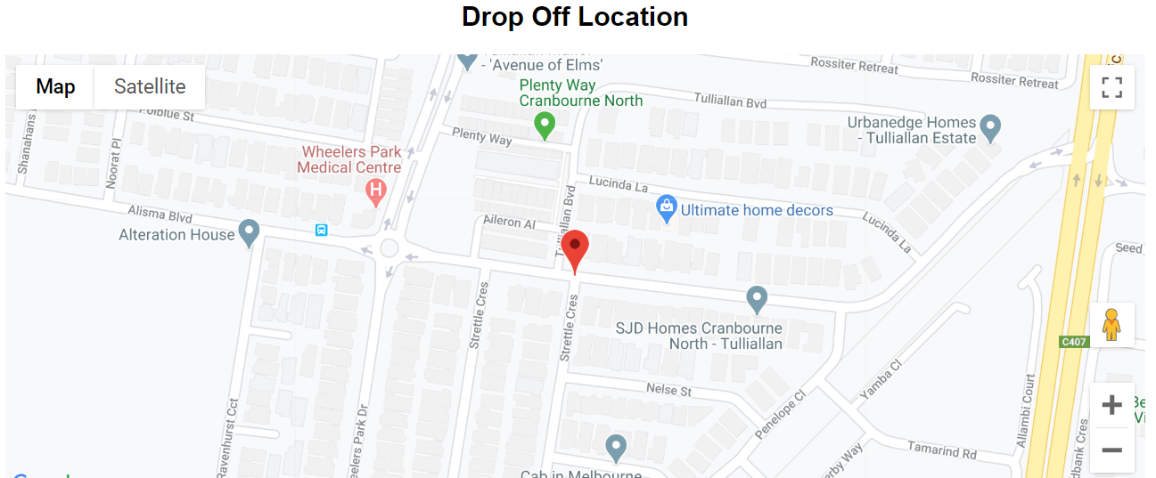
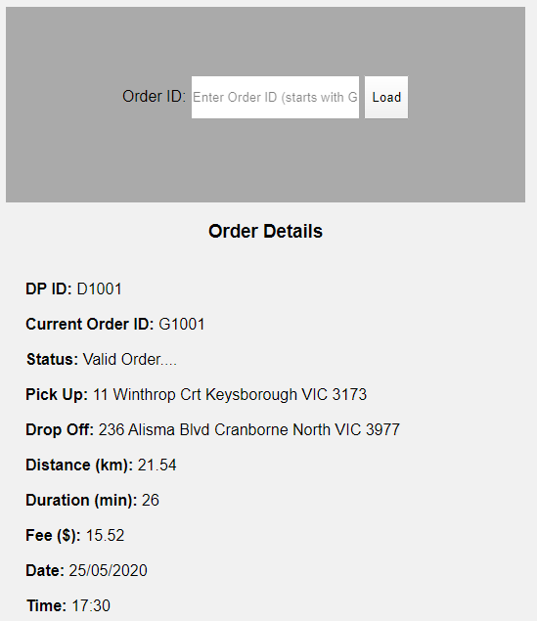
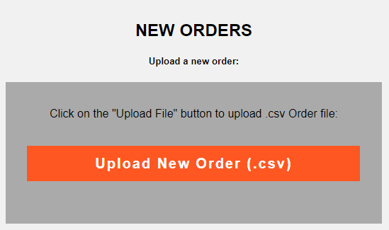
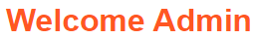
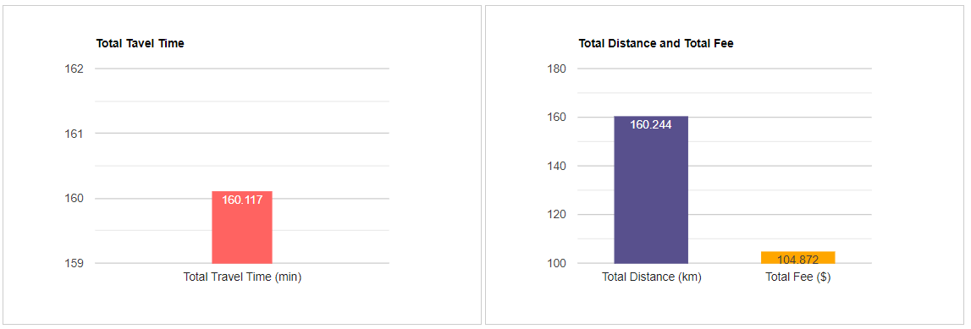
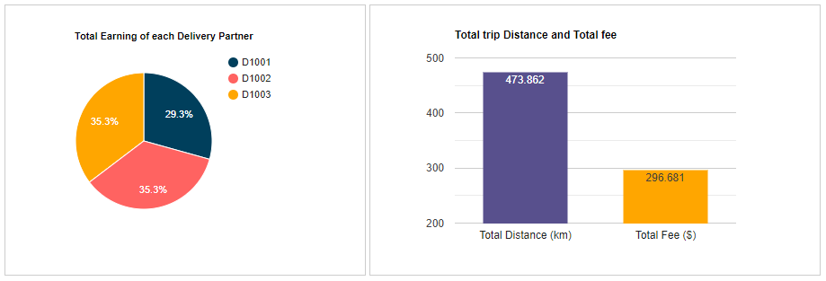
Web Application
Some of the Features Developed in the Web App
Login for Admin and DPs
Drop-off Location on Map
Query Orders Admin and DPs
Upload Orders
Dashboards

Slide 6
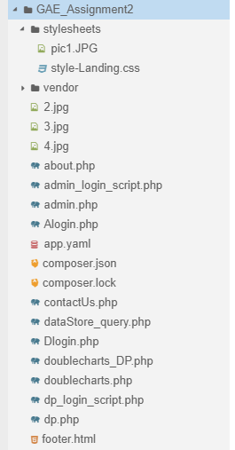
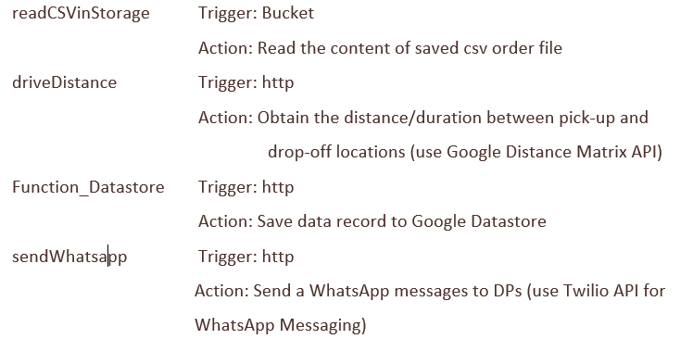
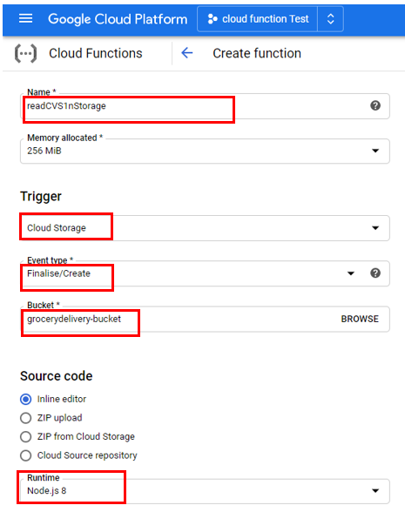
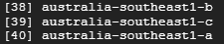
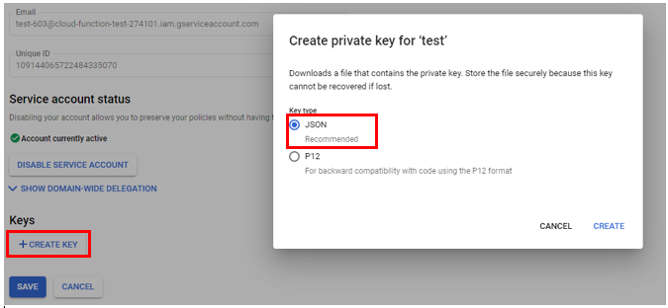
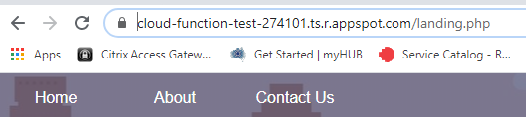
Implementation
Cloud App Engine
Develop and Host the Web Application
Coding Language – PHP, HTML/CSS, JaveScript,
Create Project
Build PHP/HTML/CSS Files and Save them accordingly
Go to Cloud Console and Initialize the Project
Select the Local Region
Deploy the Project
Browse the Project
Get the URL and Browse it on a Web Browser
Cloud Functions
Four Functions Implemented ->
Cording Language – Node.js
Create Cloud Function
Select Trigger Type
Set the Dependencies in Package.Json file
Install Client Libraries through npm
If Need - Create Service Account and Key
Deploy the Function
Refer to the Report for Function Specific Implementation

Slide 7
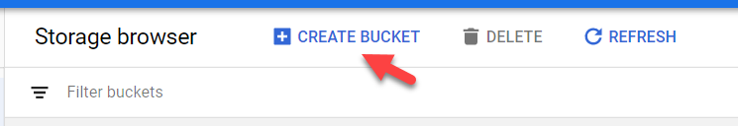
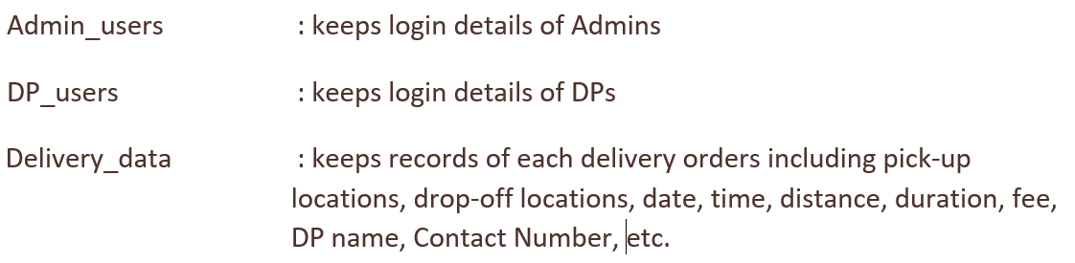
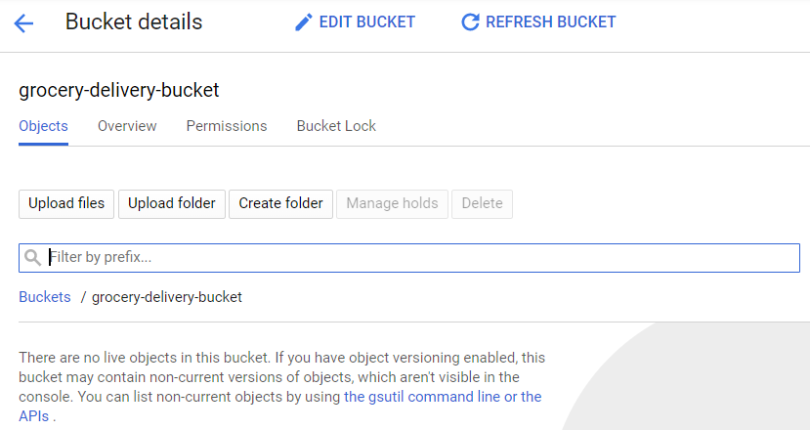
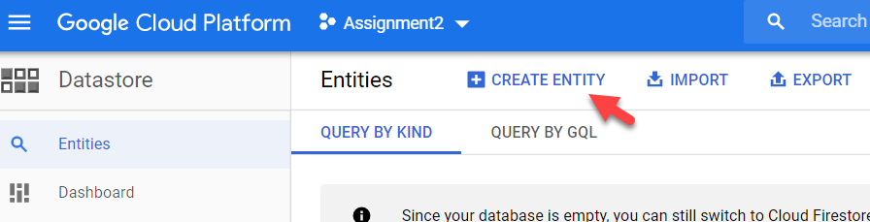
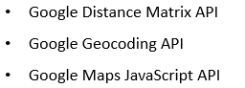
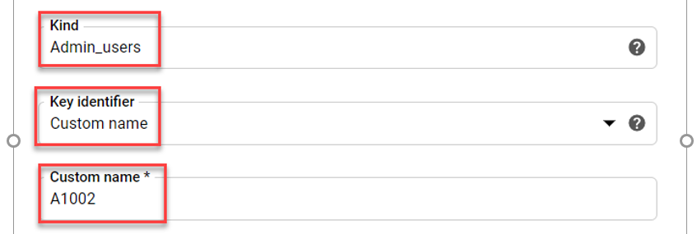
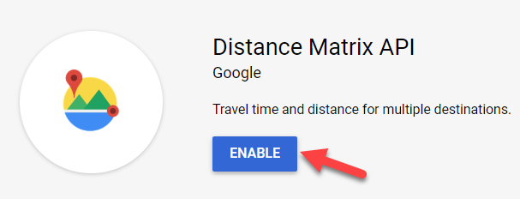
Implementation
Cloud Storage
Go to Cloud Storage and Create a Bucket
Give a Bucket a Name
Cloud Datastore
Three Kinds were Implemented ->
Go to Current Project > Storage > Entities
Create Entities
Provide the Kind Name, Key Identifier, and other Properties
Refer to the Report for Kind Specific Implementation
Enabling Google APIs
Three Google APIs are used ->
Go to APIs & Services > Library > Search for API > Enable it
Create API Key

Slide 8
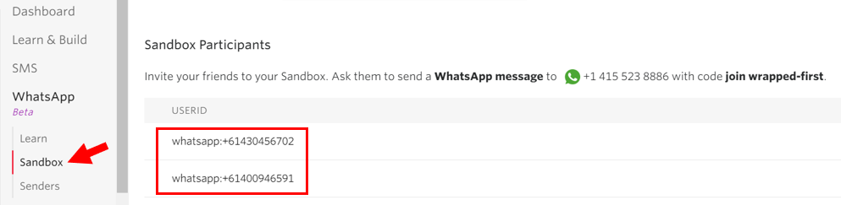
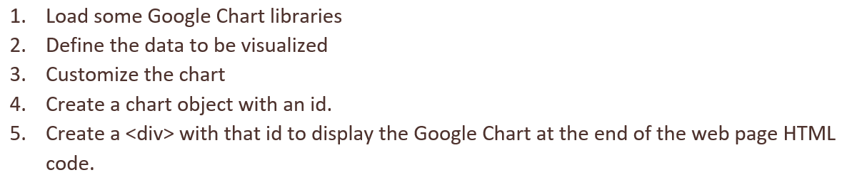
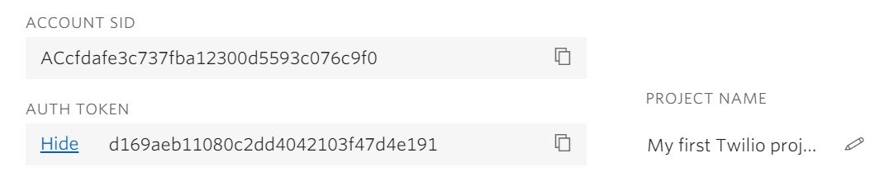
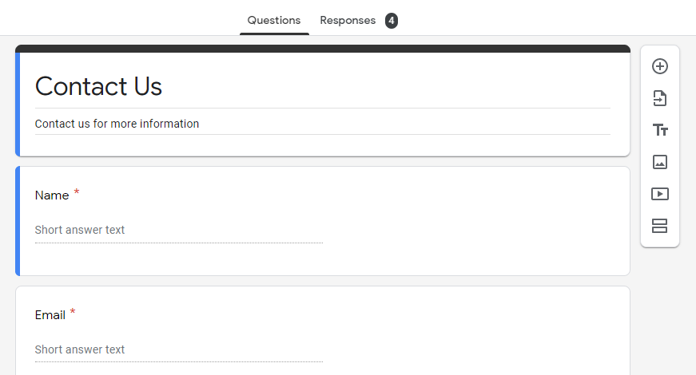
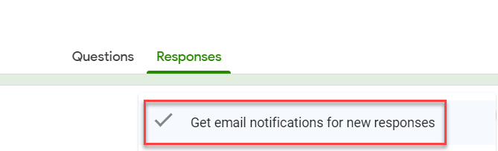
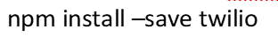
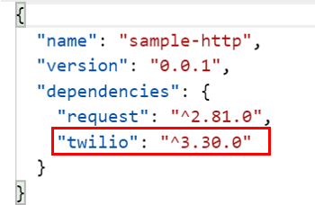
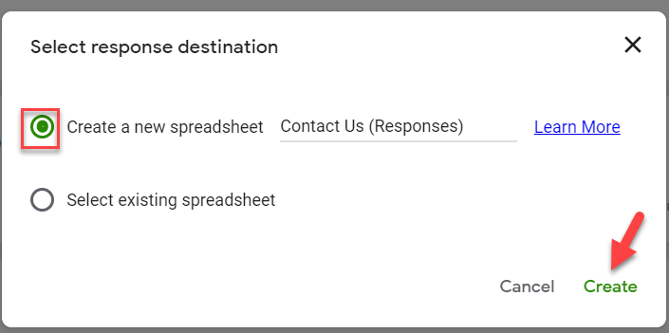
Implementation
Twilio API for WhatsAPP
Sign-up and Activate Twilio Sandbox for WhatsApp. Add Test Number
Get Twilio Account Credentials
Install the Dependencies vis npm,
Include the Dependencies in Package.json file,
Google Charts
JavaScript has been embedded in the web page HTML code
Google Forms
Use in Contact Us Form
Do the setting to get email notification
Create a Google Sheet to store the Contact Us Form Entries

